Slide 1

PROJETO ALFRED
Henrique Malone

Slide 2

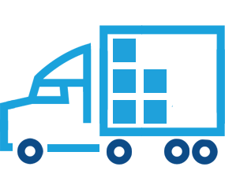
Distribution Cost Overview
Logistic budget represents 42% of controlled costs
with a total annual budget of 252 €m
79.5 €m
2.6%TO
172.9 €m
5.6%TO

Slide 3





How freight efficiency is measured?
Adherence
Truck Profile
How is the split between
CAPTIVE and SPOT carriers?
How is our MODAL mix behaving? Tiny trucks, big trucks, ships, trains?
Price
Freights
Efficiency
How is varying the FREIGHT RATE for each of the routes we operate in?
Truck Capacity
Are we so flexible to our customers that we send a truck with only a few pallets? Are our trucks IDLE?
Region and route mix
Our cost per trip varies according to the routes used and the
DISTANCE TRAVELLED

Slide 4

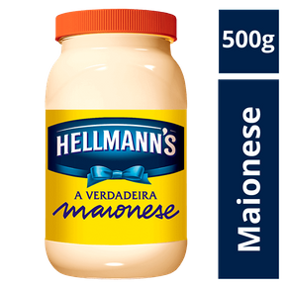

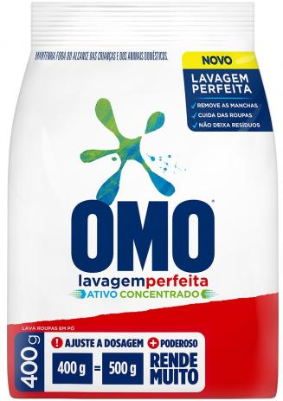
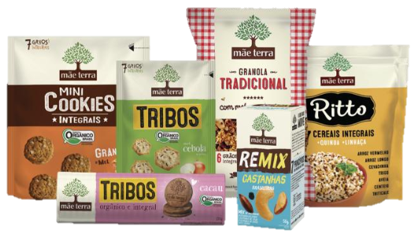

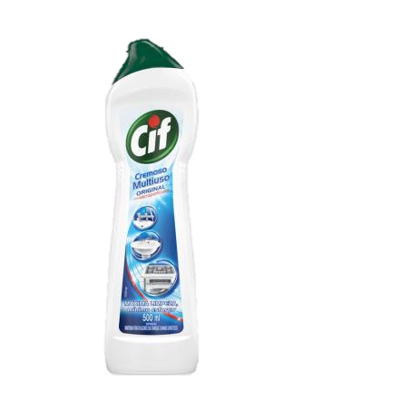
We need to understand how each of our businesses operate logistically to drive better decisions to each category
We have extremes when looking at how we operate different categories in our portfolio
FOODS
HOME CARE
HIGH PICKING
LOW WEIGHT
HIGH WEIGHT
LOW PICKING
LOW DENSITY
HIGH DENSITY

Slide 5

Do we have tools for that today?
We have extremes when looking at how we operate different categories in our portfolio
Our CORE SYSTEMS were not designed to have this level of detail easily available
No
To deep dive into category’s efficiency we need to MULTIPLY the quantity of information analyzed by 10!
FOODS
HOME CARE
DATA MANAGEMENT at this level is complex
HIGH PICKING
LOW WEIGHT
HIGH WEIGHT
LOW PICKING
LOW DENSITY
HIGH DENSITY

Slide 6




ALFRED will change how we look at Logistic Costs
FASTER
PROCESSING
CONNECTED
DATA
INSIGHTS
Using data to make better business decisions and reduce costs
Better understand variations, identify bleeders, improve operational efficiency
}
INFORMATION
AT HAND

Slide 7







Flow chart of proposed solution
Thousands of lines of data generated daily
Built-in macro to extract data daily
Python and VBA to organize data
Python to feed the data lake
DAX to calculate

Slide 8
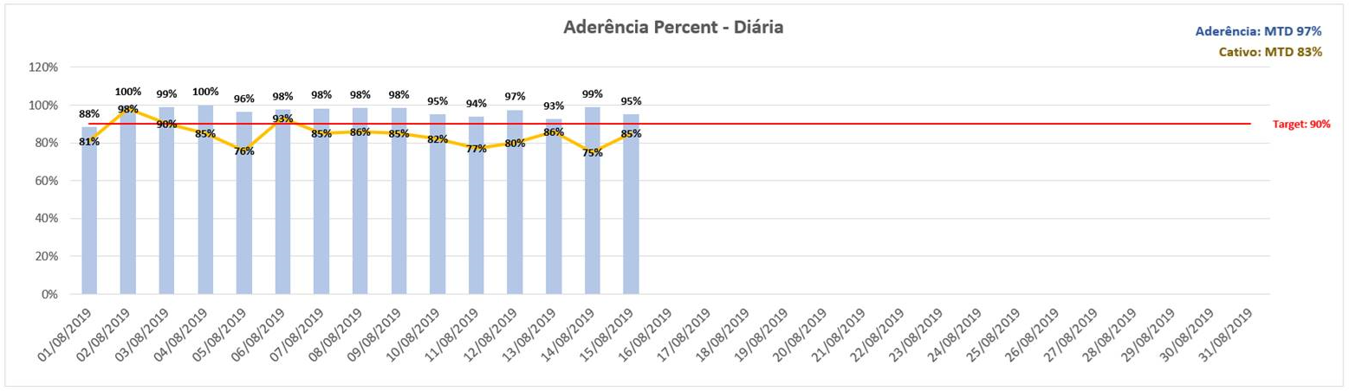
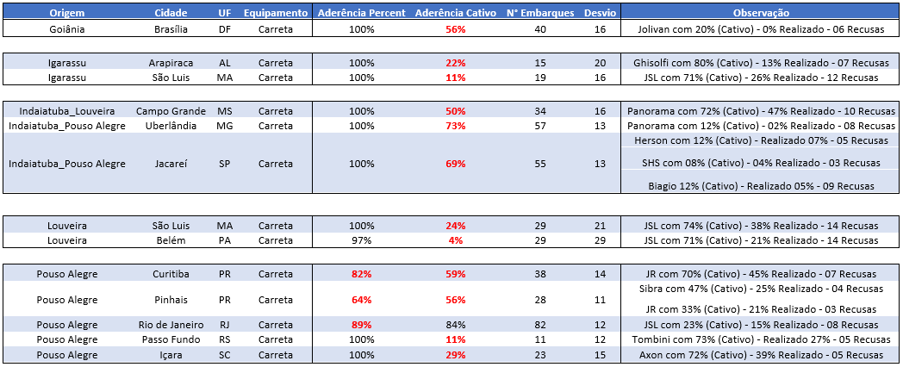
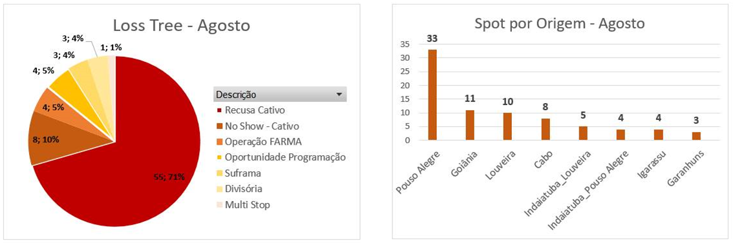
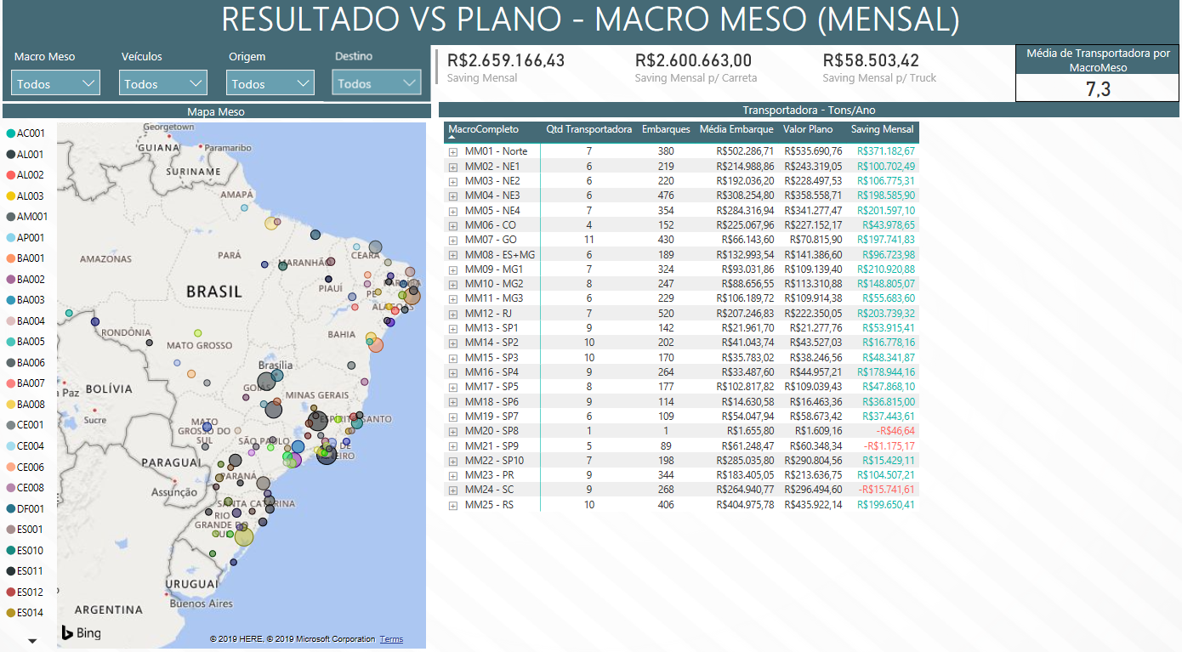
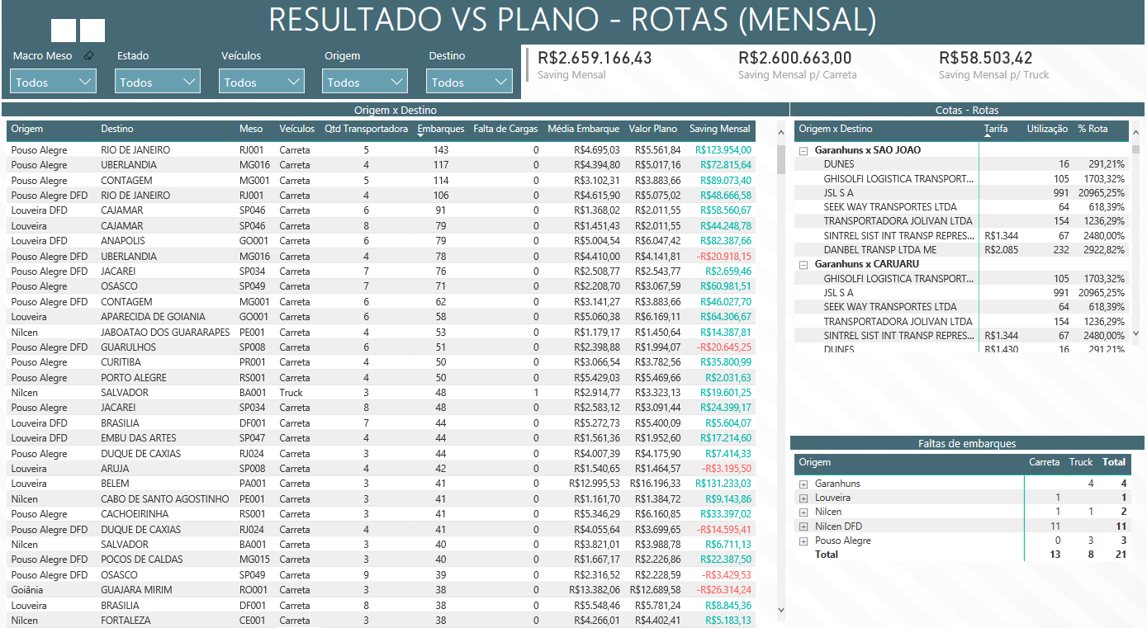
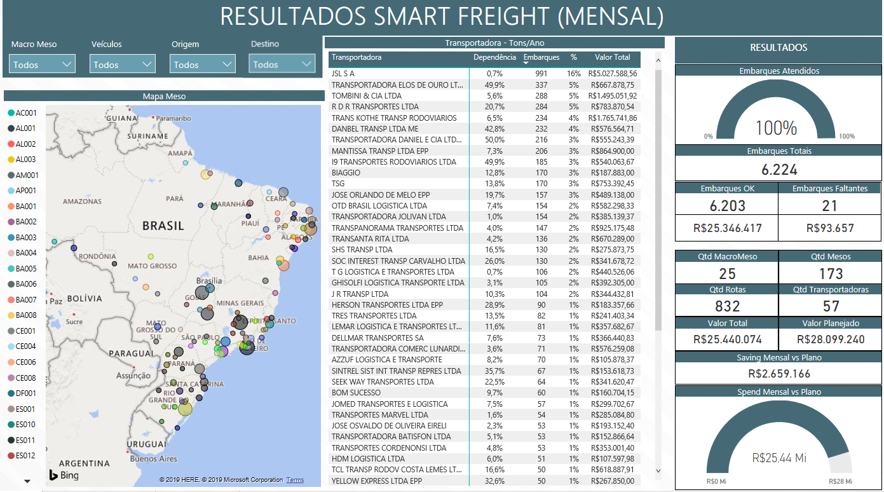
Power BI Prototype

Slide 9
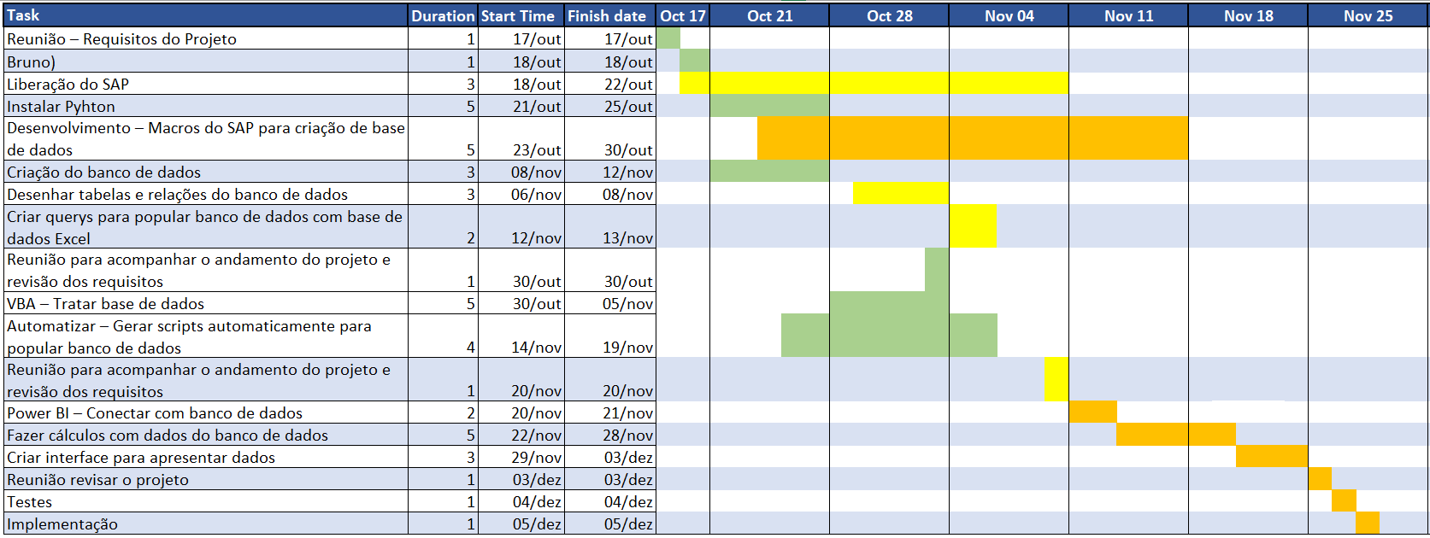
Roadmap to solution

